Slide 1






PATH TO PROGRESS
Unlocking Mining’s Potential
Overcoming Barriers to Technology Adoption
Follow us
on LinkedIn

Slide 2


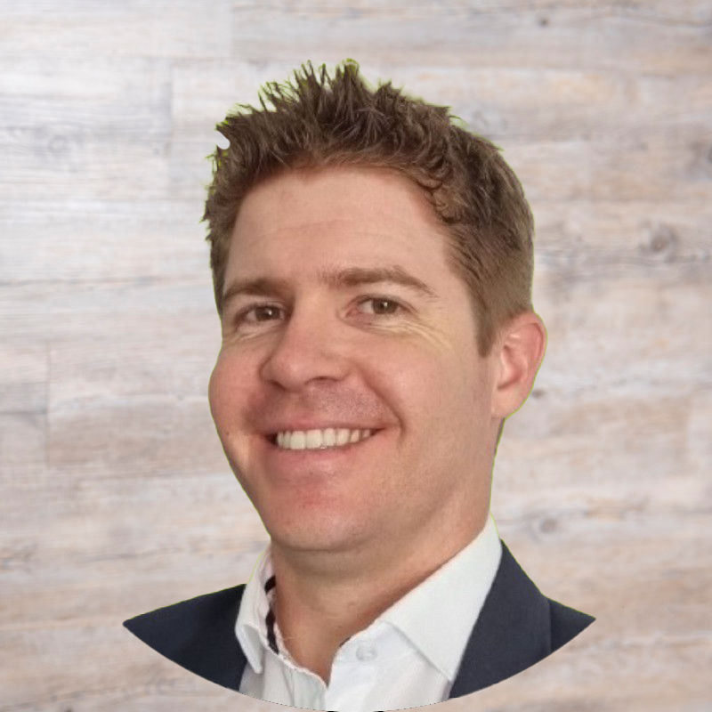
PATH TO PROGRESS
KEYNOTE
Alex Franklin
First Principles Consulting
Notes:
Duncan to introduce
Alex is a Chartered Engineer with extensive international experience spanning Australia, Panama, the UK, Spain, and Qatar. His career encompasses the entire engineering lifecycle, from study management to demolition, across infrastructure, defence, transport, and telecoms. He’s now focused on the mining sector.
Frustrated by systemic operational challenges, Alex stepped away from traditional project work to pursue his entrepreneurial side. This ultimately led him to a role as Managing Director at First Principles Consulting, where he is channelling his diverse expertise and personal interest in investing into a unique solution, the Mining Value Index.
The Mining Value Index is designed to bridge the gap between operations and investment success. While the Index is not the primary focus of his presentation today, Alex will be sharing many of the proven frameworks that underpin its methodology, as there is considerable overlap with effectively overcoming barriers to technology adoption and unlocking sustainable value.

Slide 3

PATH TO PROGRESS
From Resistance to Results
Overcoming Barriers to Technology Adoption
Notes:
Good afternoon.
A boss once told me "with context, comes understanding" and that has stuck with me throughout my career.
So, first, I want to zoom out and take a look at the current state of the industry before diving into our Operational Performance Framework, and the biggest mistakes we see.

Slide 4
Headwinds on the Horizon
Productivity Paradox
  The promised benefits and economies of scale don’t eventuate.
McKinsey Mining Productivity Index
  Productivity remains ~25% lower than mid-2000s levels.
Accenture Billion Dollar Blind Spot Study
  ~$67B in forecast revenue lost, globally, since 2020
Notes:
It's hard not to notice that the current approach is failing miners, investors and suppliers alike.
It all comes back to the Productivity Paradox.
- We see more and more money invested in new and advanced tech as well as training and improvement projects yet, productivity isn’t improving. In many cases, it’s declining.
McKinsey, through their MinLens, has been tracking productivity for some time. Even accounting for deeper and lower grades, they agree that productivity has fallen over the last 20 years.
Accenture started a study in 2020 that has been running continuously since.
- 61% of quarterly targets missed

Slide 5
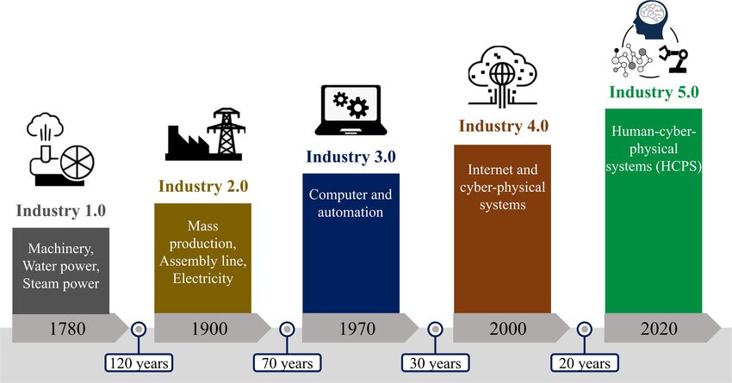
Accelerating Industrial Revolutions
Notes:
At the same time, the time between industrial revolutions. It's reducing exponentially.
We are in the middle of an Agentic shift, yet like the middle of the dot com boom when everyone had a website, and Netscape was the browser of choice, the future is unclear.
What we do know is that history doesn't repeat, but it rhymes.
Those that were successful in the past, were those able to ride the wave of disruption, not get dumped by it.
They not only see the immediate benefit from the disruption but will be able to buy their competitors for cents on the dollar, that is, if there are any assets worth salvaging.
The obvious and over-quoted example is Blockbuster and Netflix. One is now a household name, the other a relic of a bygone era.
We all think it can't happen to us, until it does.

Slide 6

A Balancing Act
Supply
Resilience
Demand
Innovation
Disruptions are only increasing
E.g. Covid, remote working, supply chain disruption, wars, and more
Notes:
To add to the challenge, most sites are already supply constrained and demand is predicted to only rise, particularly for commodities related to the energy transition and decarbonisation.
With everything going on, with disruptions only increasing, more than ever, organisations need operational resilience yet at the same time, be able to embrace innovation

Slide 7
Digital Transformation in Mining
70% of digital transformations fall short of their objectives.
(McKinsey)
73% of mining companies see local skills gaps as the biggest barrier to adopting new technology.
(World Economic Forum)
74% of mining and metals executives say integrating new technology is a key challenge, compared to 37% for all sectors.
(EY)
Notes:
When looking at how the industry currently handles digital transformation, the statistics are particularly stark, especially when compared with other industries as pointed out by EY.

Slide 8
Incremental vs Transformational
Business Improvement within departments is important, but it’s impact will only ever be incremental.
Transformation requires a holistic approach,
It requires involvement from all functional disciplines.
High performance operations are a team sport.
Notes:
I think a lot of this comes back to a dominance in incremental thinking.
When you introduce new software or technology, many people think functionally within departments, but it often requires cross functional support from others like HR, L&D, leadership and more.
Athlete example:
- Genetic advantage yet they still do everything they need to to maximise their performance like training, recovery, diet, mindset and so on.
Athletes are not just optimising one aspect. They don't just add training volume without adjusting their diet and recovery.
Business is complex, when you introduce a new technology, are you considering all the variables and impacted functions? Those that may need to be consulted and informed?
---
Nobody said change would be easy, if it was, everyone would do it well.

Slide 9
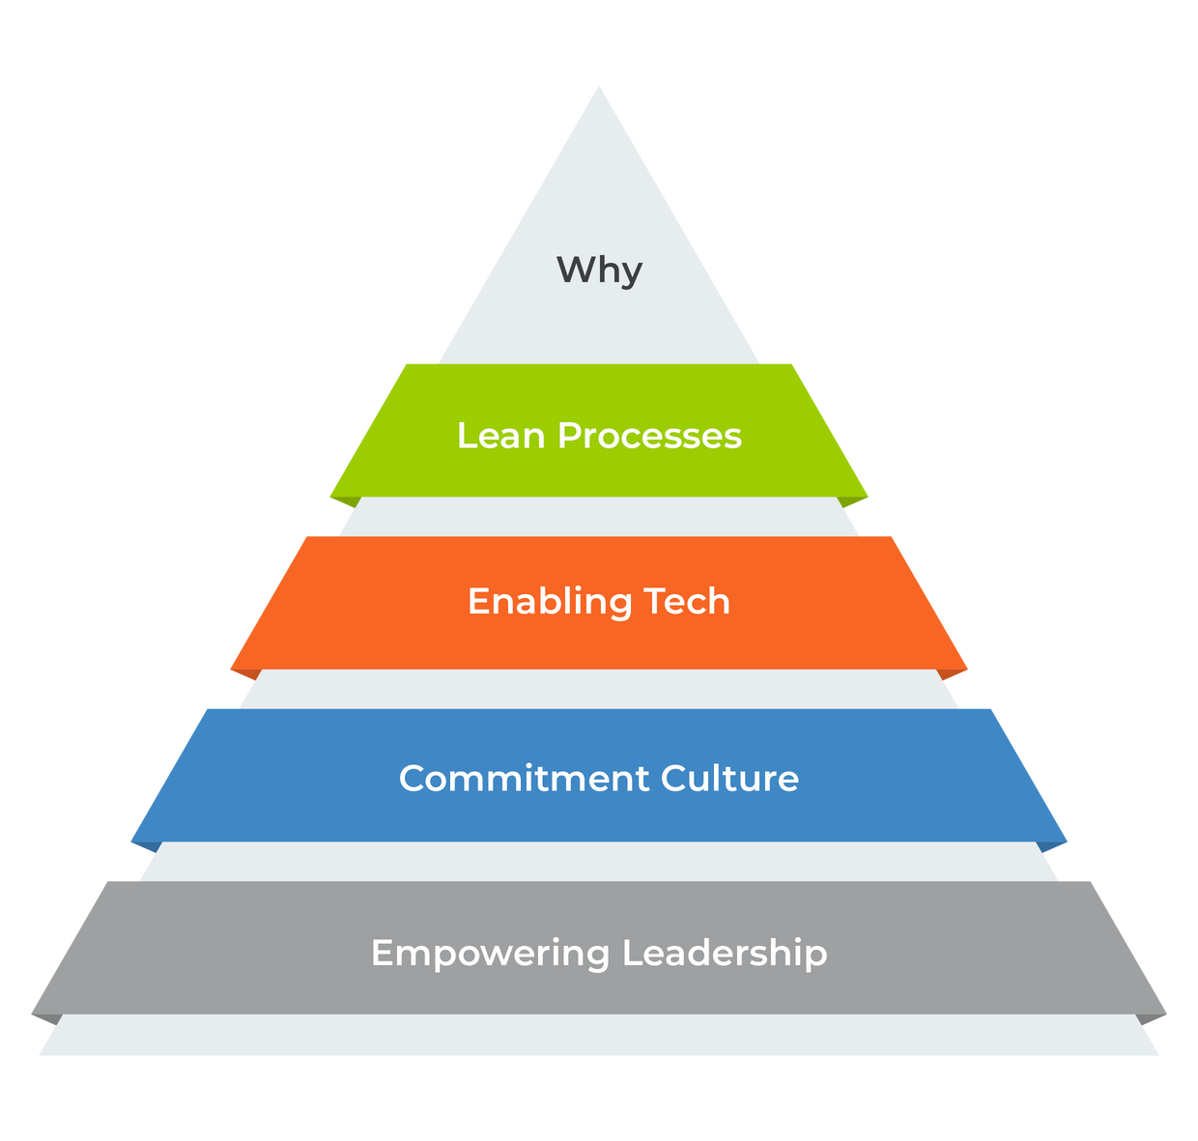
The Operational Performance Framework
Notes:
How do we shift away from incremental thinking and start thinking longer term and bigger picture and why is it so uncommon?
A holistic approach may take longer but the difference in the outcome is measured in orders of magnitude. It also lasts, because it becomes part of 'how we work around here'.
So what are all the elements you need to consider?
FPC has codified the 5 core elements for operational performance. They are...

Slide 10

A Compelling Why
It has to be bigger than the financial.
Questions to ask yourself
  What is the reason for this change?
  Why are we implementing this tech?
  Have we clearly communicated?
  Has it been understood?
  Just because it’s clear to me, is it clear to others?
Notes:
Starting with a compelling why.
This sits at the centre of the framework.
A compelling why must exist for an organisation, a team, an individual and a change.
The financial outcome is just table stakes. There has to be a bigger why, beyond revenue and a pay check.
If you're familiar with Simon Sinek's Golden Circles, you'll understand that A Compelling Why MUST sit at the centre of everything you do as a company, team and individual.
Without it, you'll only find change resistance and change fatigue.

Slide 11
Mistake 1: No Mandate
“We chose to go to the moon.
We choose to go to the moon in this decade and do the other things not because they are easy, but because they are hard.
Because that goal will serve to organize and measure the best of our energies and skills, because that challenge is one that we're willing to accept. One we are unwilling to postpone.”
JFK, September 12, 1962
Notes:
A compelling why creates strategic alignment from top to bottom and is often achieved through a mandate.
JFK in his his famous speech provided the mandate.
* It was clearly communicated
* It wasn’t optional
* Everything was subordinated to this priority
Even the wording is clear is about choosing and accepting the challenge.
Anybody not onboard will automatically self select.
Just because somebody is qualified, does not mean they are a good fit and this shows up time and time again in site culture.
All of this comes back to who we hire, promote and fire (or don't fire).
The moon shot leads me to my next point.
Strategic ambition leads capability.
Capability is required to achieve strategic ambition.
It took 7 years and 9 months for capability to catch up to strategic ambition when Apollo 11 landed on the moon on July 20, 1969.

Slide 12
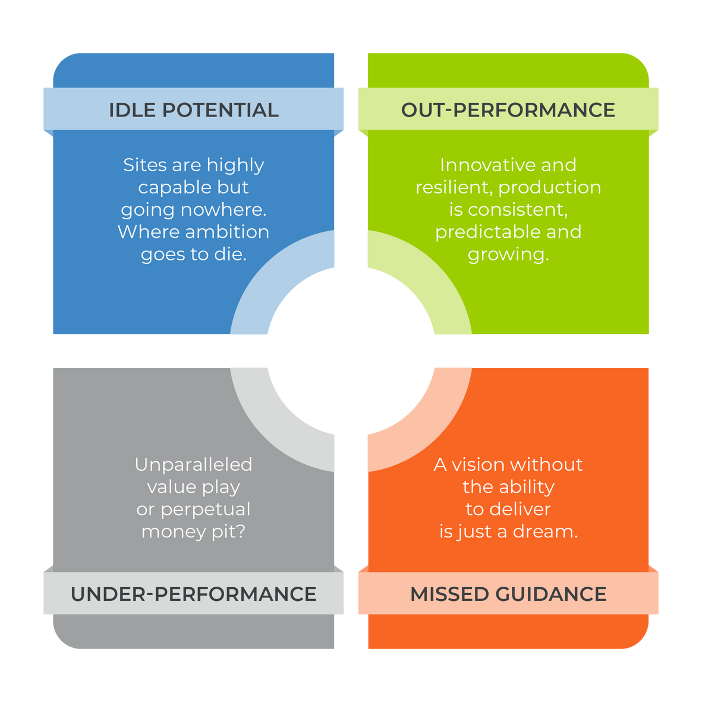
Performance Quadrants
Are our expectations realistic?

Slide 13
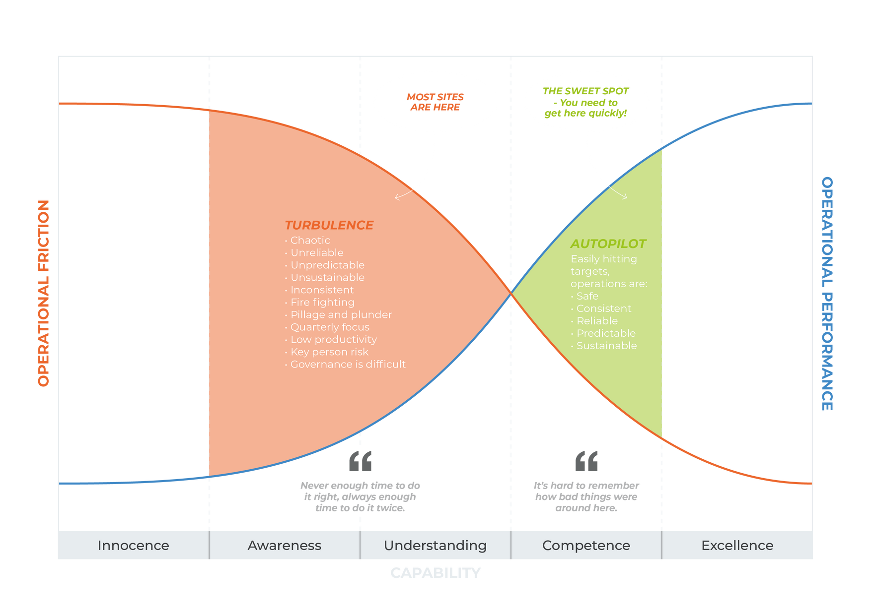
Capability Curve
The ability to execute a specified course of action, or to achieve a desired outcome.
Notes:
Let's zoom in and take a closer look at capability.
Without the appropriate level of capability, you're going nowhere.
On our Capability Curve, we measure it on a scale of innocence to excellence.
I spoke to a CEO recently that told me they had worked for a company that had missed 8 consecutive quarters. The crazy part is, companies set their own targets.
Towards the end, you can imagine how frequently they were getting calls from shareholders. It doesn't take much to imagine what conditions were like on site as they were obviously in the Turbulence zone.

Slide 14
Performance Quadrants
Notes:
Q1: Has anybody's perception of where they are on the quadrants changed?
Q2: Which way did it move?

Slide 15
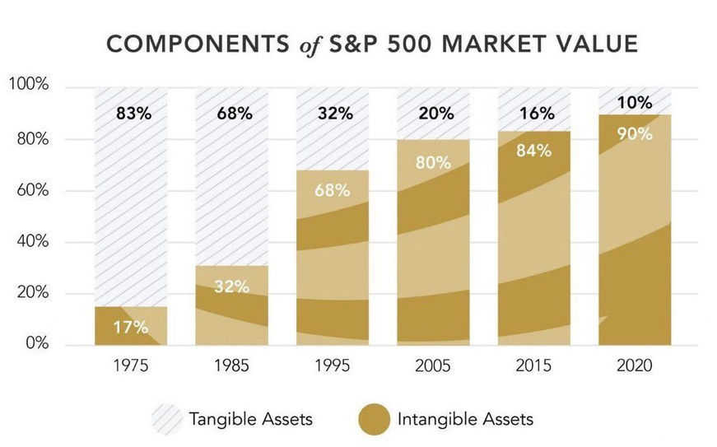
Capability is Crucial
  Will your A.I. be fed trustworthy data, or...
    Will poor data hygiene kill it?
  In a crisis, will stakeholders back you, or...
    Are those relationships on shaky ground?
  In challenging times, does your reputation help or hinder?
  Can you attract and retain top talent...
    Or are you known for burnout and bureaucracy?
  If you acquire a new asset, how quickly can you roll out best practice and generate value?
Notes:
I really want to drive home this idea that capability is THE predictive indicator of success.
I saw a recent post on LinkedIn about how the tangible and intangible value of the S&P 500 had inverted over time. In 1975, only 17% of the value of the 500 largest listed companies was intangible - things like culture, brand, systems, relationships, IP, and data.
By 2020, that had shot up to 90%.
In mining, we tend to think of a site's value by what's in the ground and the big yellow toys driving around site.
But these factors are just table stakes in mining.
It's the intangible that determines a site's success and ultimately it's value.
It's why investors will pay a management premium for the right executive team.

Slide 16

Empowering Leadership
Directing and motivating the workforce to achieve organisational goals by applying the appropriate leadership style for the situation and individual, allocating autonomy as appropriate.
Team members can then discharge their duty according to their organisational level.
This results in increased engagement, commitment and accountability.
Notes:
The next element is Leadership.
It sits at the bottom of the pyramid because it is foundational.
Without the right leadership, nothing meaningful can be achieved.
Decades of research has shown that leadership is a learned, not innate behaviour.
This means we need to teach it.
Typically, when we think of training associated with technology adoption, we think of the end user.
For any change initiative, we also need to consider the sponsor, champions, leaders and supporters.
Rarely, are people taught how to sponsor or champion a project.
In the same vein, rarely have line managers and corporate support functions like HR been trained in how to best support individuals through change.

Slide 17
Mistake 2:
A Lack of Comprehensive Training
PROSCI’s ADKAR model
Awareness - of the need for change
Desire - to participate and support the change
Knowledge - on how to change
Ability - to implement required skills and behaviours
Reinforcement - to sustain the change
Notes:
This lack of comprehensive organisational training is mistake #2.
ADKAR is a recognised framework for managing individual change.
It's based on the premise that organisational change happens when individuals change.
Awareness relates to having and communicating a compelling why at all levels - organisational, team and individual.
We will cover how to create desire in the next step.
Assessing and assigning tasks based on knowledge and ability is what was just on the previous slide.
Finally, reinforcement is required to sustain the change.
---
An example of this is many sites run on Excel Spreadsheets, with every team member running their own version and data set. Many times, it takes outlawing Spreadsheets to reinforce that this change is permanent and important. Excel is not an Enterprise software and only increases data and key person risks.

Slide 18
Commitment Culture
  The workforce is hired for eligibility and suitability
  There is a tangible ‘esprit de corps’
  Communications and expectations are clear, unambiguous and people are aligned on the ‘Why’
  There is openness, trust and accountability across departments and functions
  A competency framework is in place and people are not subjected to ‘sink or swim’
  Motivation is not purely financial
Notes:
Element #3 is Culture. It is the other side of the leadership coin.
Ideally you have a culture of commitment. This is best described as high discretionary effort.
A committed workforce is motivated intrinsically and therefore more engaged, productive, accountable and willing to go the extra mile.
The contrast to this is a compliance culture where people's actions, like hours worked, must be logged and tracked.
Compliance is hard to sustain as it must be perpetuated extrinsically and is administratively costly.
I mentioned earlier that who you hire, fire and everything in-between will be a key determinant of culture.
Too often, we see strong personalities, the hammers that think everything is a nail, promoted again and again because they are high impact and highly visible. But, their short term results come at the cost of mid and long term performance. They poison the well.
You've heard the saying people don't leave bad companies, they leave bad bosses. That's who this saying is talking about and yet they keep getting promoted and leaving a trail of destruction in their wake.

Slide 19
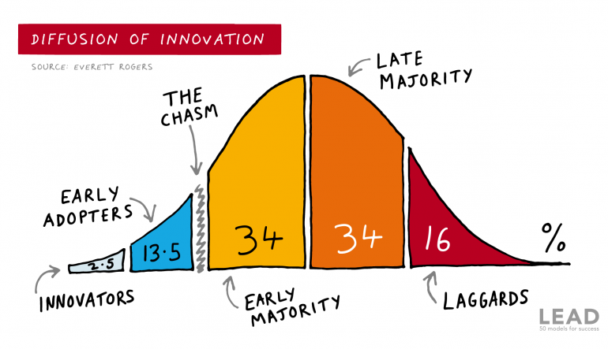
Mistake 3: Disobeying the law
https://www.long-intl.com/articles/cost-control-project-manager/
Notes:
Change Management is a topic unto itself and I don’t have time to do it justice. Instead, I want to focus just on creating desire, the second aspect of the ADKAR framework.
Mistake #3 is trying to push desire through an organisation, rather than create a small, intense amount of interest and letting it build. Essentially, create a sense of FOMO, fear of missing out, in the organisation.
The innovation of diffusion curve is not new. It was created in 1962 and has withstood the test of time.
- The first 2.5% are the innovators. The Steve Jobs and Elon Musk's of the world (before he got political)
- Early adopters are willing to sacrifice their time, money, or energy for something that's important to them. These are the people that line up overnight to be first to buy an product or see a movie.
- The laggards at the tail end probably shouldn't be working for your organisation. Too often we try to placate them when the reality is that is bad for the business.
- Ultimately, we need to get the middle 68%, the majority onboard, in order to have a cultural shift.
The problem is they are cynical - WIIFM? Will you pay me extra?
- You cannot win the majority until you reach the tipping point of about 16% market penetration.
This is called crossing the chasm.
- If you ignore this, you'll only ever get ~10% because this is the portion of the population that 'just get it'. These are the risk takers that want the social status of being first. These are the people that buy first gen products, even though they are sub-standard.
You need to focus on the early adopters.
Example:
200,000 people company wanted SS to do a millennial training program.
- Design program
- Record videos
- Force all millennials to go through the program
Instead, he did 1 workshop, once, open to anybody born after 1984. Kept senior execs out.
- Only had 100 seats
- Had to apply via an essay (extra time and energy - early adopter)
- Only open to a few offices
After the workshop, asked for volunteers to create a the program.
- extra hours, no extra pay
- no personal benefit
- 50 people apply
Senior exec calls Simon furious that he's been getting calls from every other office for 2 weeks demanding their own millennial training program.
That's one way to create demand in the majority.
If you pitch straight to the majority, you're going to get resistance - no time, too busy, WIIFM?
* How can you identify and engage the innovators and early adopters?
* How can you cross The Chasm?

Slide 20
Enabling Tech
  Fit-for-purpose
  May provide a competitive advantage
  Must enables the strategic ambition
  Implementation considers all elements
Notes:
Element #4 is fit-for purpose technology and tools. We call these Enablers.
In the same way that "the tools don't make the tradesman", your success does not come soley from technology.
That's not to say that a skilled tradie does need good tools to do great work.
Only that you need all elements in order to be successful.
Yet, we continually see organisations and individuals alike looking for the next shiny object. I call it SoS, short for Shiny Object Syndrome.
Shiny objects are appealing because these are sold as silver bullets. By now, you should understand that they can only ever be part of the solution, not the whole solution.
Whilst they may provide a competitive advantage, they are not THE competitive advantage.
At the other end of the scale is legacy that keeps organisations stuck. When I was working in the UK over a decade ago a series of large engineering firms collapsed. Many of them had gone through aggressive periods of growth, continuing with the legacy platforms acquisitions. This means information didn't flow upwards and they lacked visibility, oversight, governance and control of the different acquisitions because the data was trapped in legacy software. Like a house of cards, it only took one going south to bring down the entire company because they didn't understand their true debt and cashflow positions.

Slide 21
Mistake 4: Silver Bullet thinking
  A.I. improves what is already there but it cannot
    Lead teams
    Create a commitment culture
    Communicate a compelling why
  Needs a human in the loop
    It can’t be held accountable
  A.I. requires a high level of operational capability as an input (garbage in, garbage out)
    Good data, processes, knowledgebases, etc.
Notes:
Mistake #4 is this silver bullet thinking.
The most topical example is A.I.
It's an incredible tool and we are incorporating it into different aspects of our business, but AI isn’t the silver bullet many think it is.
In fact, it may be the wave of disruption that dumps many companies as it relies on high quality data. We typically find that most data is not owned and there is no single source of truth.
Think about how many people run their own Excel sheets in your team. You can almost guarantee that each engineer has their own.
Mine sites are not like other industries like marketing agencies where a high level of automated Agents can be running around unsupervised sending out meeting requests and running LinkedIn ads. There is a time and place for Agents but especially in transition periods we need humans in the loop.
Without the requisite capability, A.I. can't be easily implemented anyway.

Slide 22
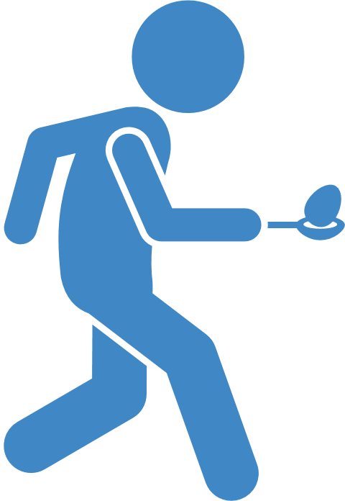
Lean Processes
“The first rule of any technology used in a business is that automation applied to an efficient operation will magnify the efficiency. The second is that automation applied to an inefficient operation will magnify the inefficiency.” - Bill Gates
Notes:
The final element is Processes.
If culture is the other side of the leadership coin, processes and technology are different sides of the same coin.
Processes need to be both effective and efficient.
Think of this like an egg and spoon race.
* If you win but your egg is cracked on the ground, you haven’t reached your goal
* Effectiveness is meeting your objectives
* Efficient means you’re doing it an economical way

Slide 23
Mistake 5: Half Completed Projects
  In Project Management, the 5 phases are initiating, planning, executing, monitoring & controlling, and closing
    Projects are often poorly planned but almost never closed correctly
  Is it owned?
    If not, it will eventually become non-functional as everything around it changes
    Is it meaningful or just another responsibility?
      Is it monitored?
  Consider key person risk
Notes:
The Fifth mistake is half completed projects.
Projects are rarely closed properly because ownership is not assigned.
Technology projects now risk becoming the new photocopier or coffee machine. That is, common office equipment. Anything that isn't owned, isn't maintained or updated.
When things like photocopiers are out of order or ink, it's generally nobodies job to fix it, yet everyone is affected. Individuals are too busy to fix it and often lack the authority to order repairs or new supplies.
There should be a simple process and approvals document but if the person that used to do it isn't around, nobody knows what to do.

Slide 24
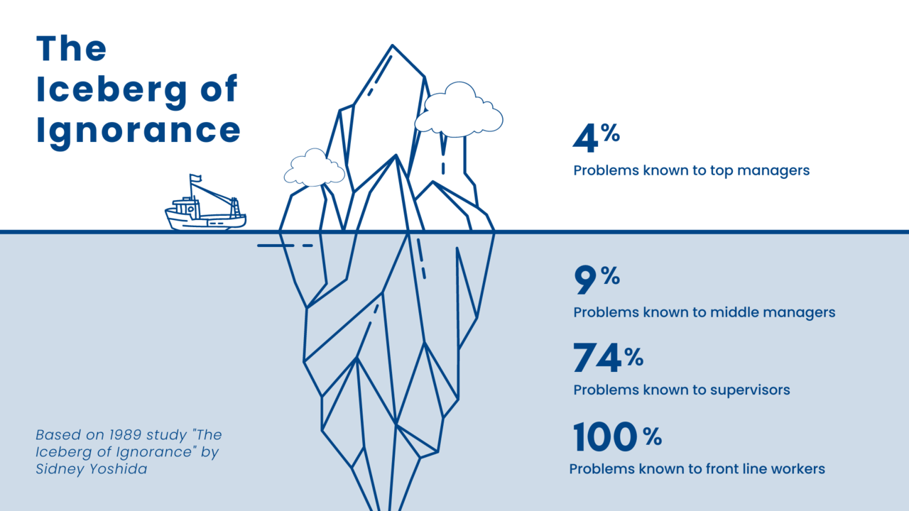
Mistake 6: Too Little, Too late
Notes:
This brings us to the final mistake, too little, too late.
One thing we’ve observed over the years is sites commit to technology projects expecting them to transform their operations, only to find out the hard way that they don’t have the requisite capability.
It’s only once the decisions have been made and the project is underway, near completion or up and running that leaders realise what those on the ground have been trying to tell them all along.

Slide 25
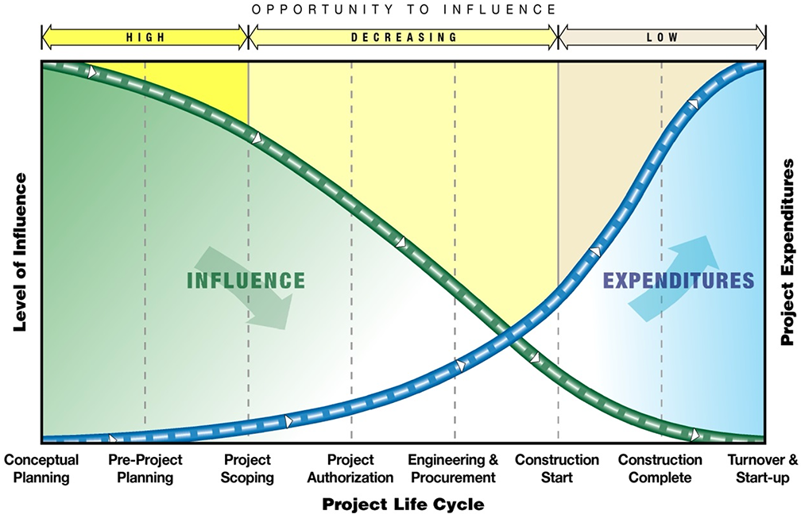
Cost Curves
https://www.long-intl.com/articles/cost-control-project-manager/
Notes:
You're probably familiar with the engineering cost curves on the left.
Typically, as consultants, we are only called in when the curves have intersected.
You'll hopefully see the similarity between that and our Capability Curve. This isn't a coincidence.
Without the right capability across all 5 Operational Performance Elements it's going to take longer and cost more.

Slide 26
Increasing Capacity at a Gold Mine
Situation: currently building a larger plant to replace the old, with a plan to significantly increase the workforce.
Outcomes: When the new, state of the art plant comes online...
  Will the current operators take their bad habits with them?
  Will the new hires pick up these bad habits?
  Will the plant ramp up in the expected time frame?
  Will production be predictable, reliable and consistent?
  Will the productivity paradox continue?
With the benefit of hindsight, how would you have approached this?
Notes:
Last year, we had an urgent call for help from the processing department of a gold mine.
They told us that the existing plant wasn’t operating close to capacity. They are constantly on the back foot and trying to operate through chaos. They are in survival mode.
A decision was made to build a bigger plant, without any formal improvement to their existing operations.
What do you think will happen when this new plant comes online?
Where does this place them on the cost and capability curves?

Slide 27
The Three Frameworks
Performance Quadrants
Capability Curve
Operational Performance
Framework
Notes:
To recap...
The Performance quadrants measure the alignment of skill and will.
We use the Capability Curve to objectively measures the skill aspect.
The Operational Performance Framework is a holistic view, comprised of the 5 core elements all operations must do well to be successful.
They are:
1. Have a compelling why and clearly communicate this,
2. Empower leaders with the appropriate training and support,
3. Create a culture of commitment and not compliance,
4. Ensure tech enables processes, and that,
5. Processes are owned, lean and effective.

Slide 28
Key Takeaways
  The current approach is failing miners, investors and technology companies alike
  We need to find a way to balance:
    Demand/supply
    Resilience/innovation
By focusing on capability, you ensure that operations have the skill
to achieve their strategic ambition without undue cost or delay
Ultimately, how can you give yourself the best chance of success?
Notes:
If there is one thing you take away from this presentation, is to be fully aware of your current operational capability and it’s limitations BEFORE a project starts so that gaps don’t come as an unwelcome surprise down the track.
How can you give yourself the best chance of success?

Slide 29


When facing COMPLEX DECISIONS, always
go back to FIRST PRINCIPLES thinking.
website
Alex LinkedIn
info@firstprinciplesconsulting.com
www.firstprinciplesconsulting.com

Slide 30



See you at the next
PATH TO PROGRESS event
Follow us
on LinkedIn

