Slide 1

  AVEVA WORLD 2025
Striking Copper and Gold: How Data increased Ok Tedi’s recovery rates.
Ok Tedi’s AVEVA Data Journey with Mipac

Slide 2


Ok Tedi Mining Limited and Mipac partner for co-development
Over the past
3
decades Mipac’s team of
180
engineering professionals have delivered more than
  Ok Tedi Mining Limited (OTML) is a 100%
  PNG-owned company and contributed 7.4% to the nation’s economy.
  It mines copper, gold and silver at Mt. Fubilan in the Western Province of Papua New Guinea.
  OTML operates the longest-running open-pit mining 240kt of overburden and 60kt of ore daily at a rate of 24Mtpa.
  Our mission is to provide high-quality solutions to enhance operational performance and improve our clients’ productivity, safety and efficiency.
  A global leader in operational technology, control systems and engineering services.
  Combine our operational experience, engineering and software development capabilities to deliver tailored solutions.
  AVEVA Partner with PI Accredited Engineers.
720
projects across
55
countries for more than
110
site/operations
Notes:
Mipac:
Our mission is to provide high-quality solutions to enhance operational performance and improve our clients’ productivity, safety, and efficiency.
Over 25 years in business
Over 450 Projects delivered
100 clients globally
Combine our operational experience, engineering and software development capabilities to deliver tailored solutions
Aveva Partner - Accredited Engineers

Slide 3

1.
Background

Slide 4



Mining and Processing Operations
ORE
MINED
CRUSHED
AND
GROUND
COPPER, GOLD, SILVER EXTRACTED
DRIED AND STORED
EXPORTED
  Ore is mined and processed at an onsite flotation processing plant capable of treating up to 24 million tonnes per annum (Mtpa).
  The plant currently recovers copper, gold and silver into a saleable concentrate.
  Final concentrate is transferred to a silo and storage vessel before being exported (using commercial shipping) to customers in Japan, the Philippines, Germany, South Korea and India where it is refined to produce copper metal and gold and silver bullion.
Notes:
Graham

Slide 5
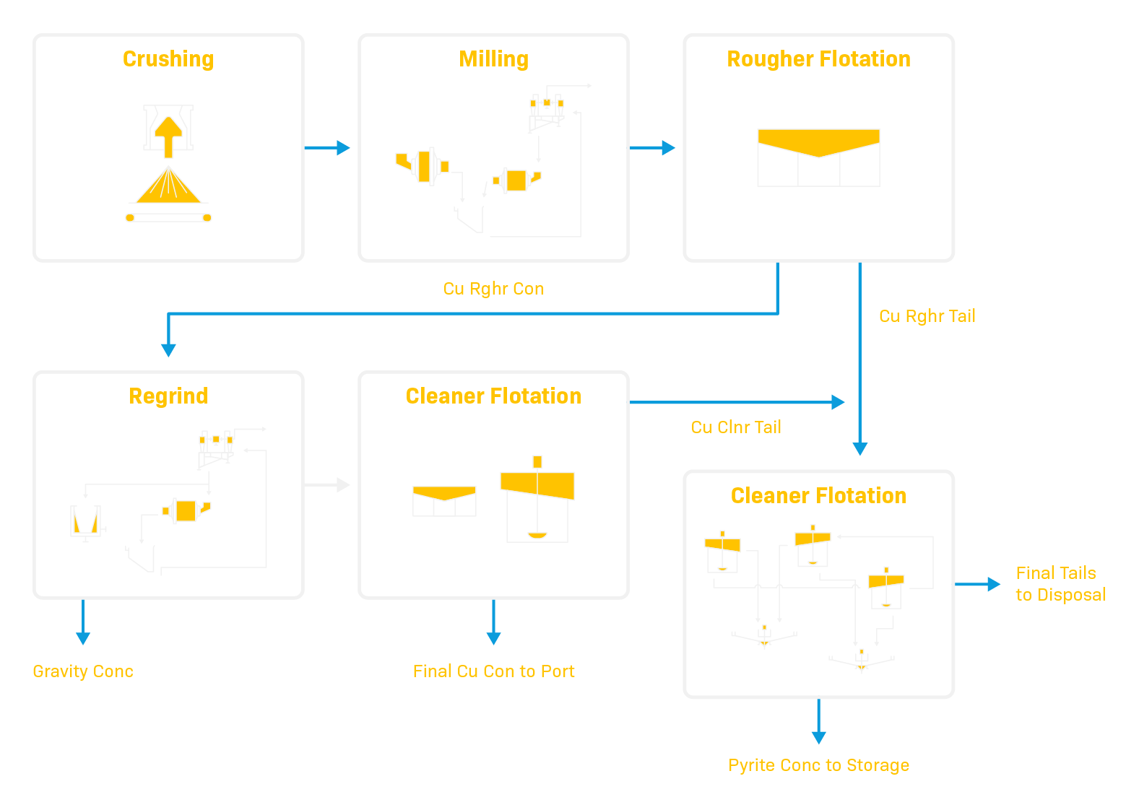
Process Flow
Notes:
Graham
Quick – 15 seconds, this is process, uses flotation for recovery and gravity circuit for gold

Slide 6
2.
The Challenge
Low Recovery

Slide 7
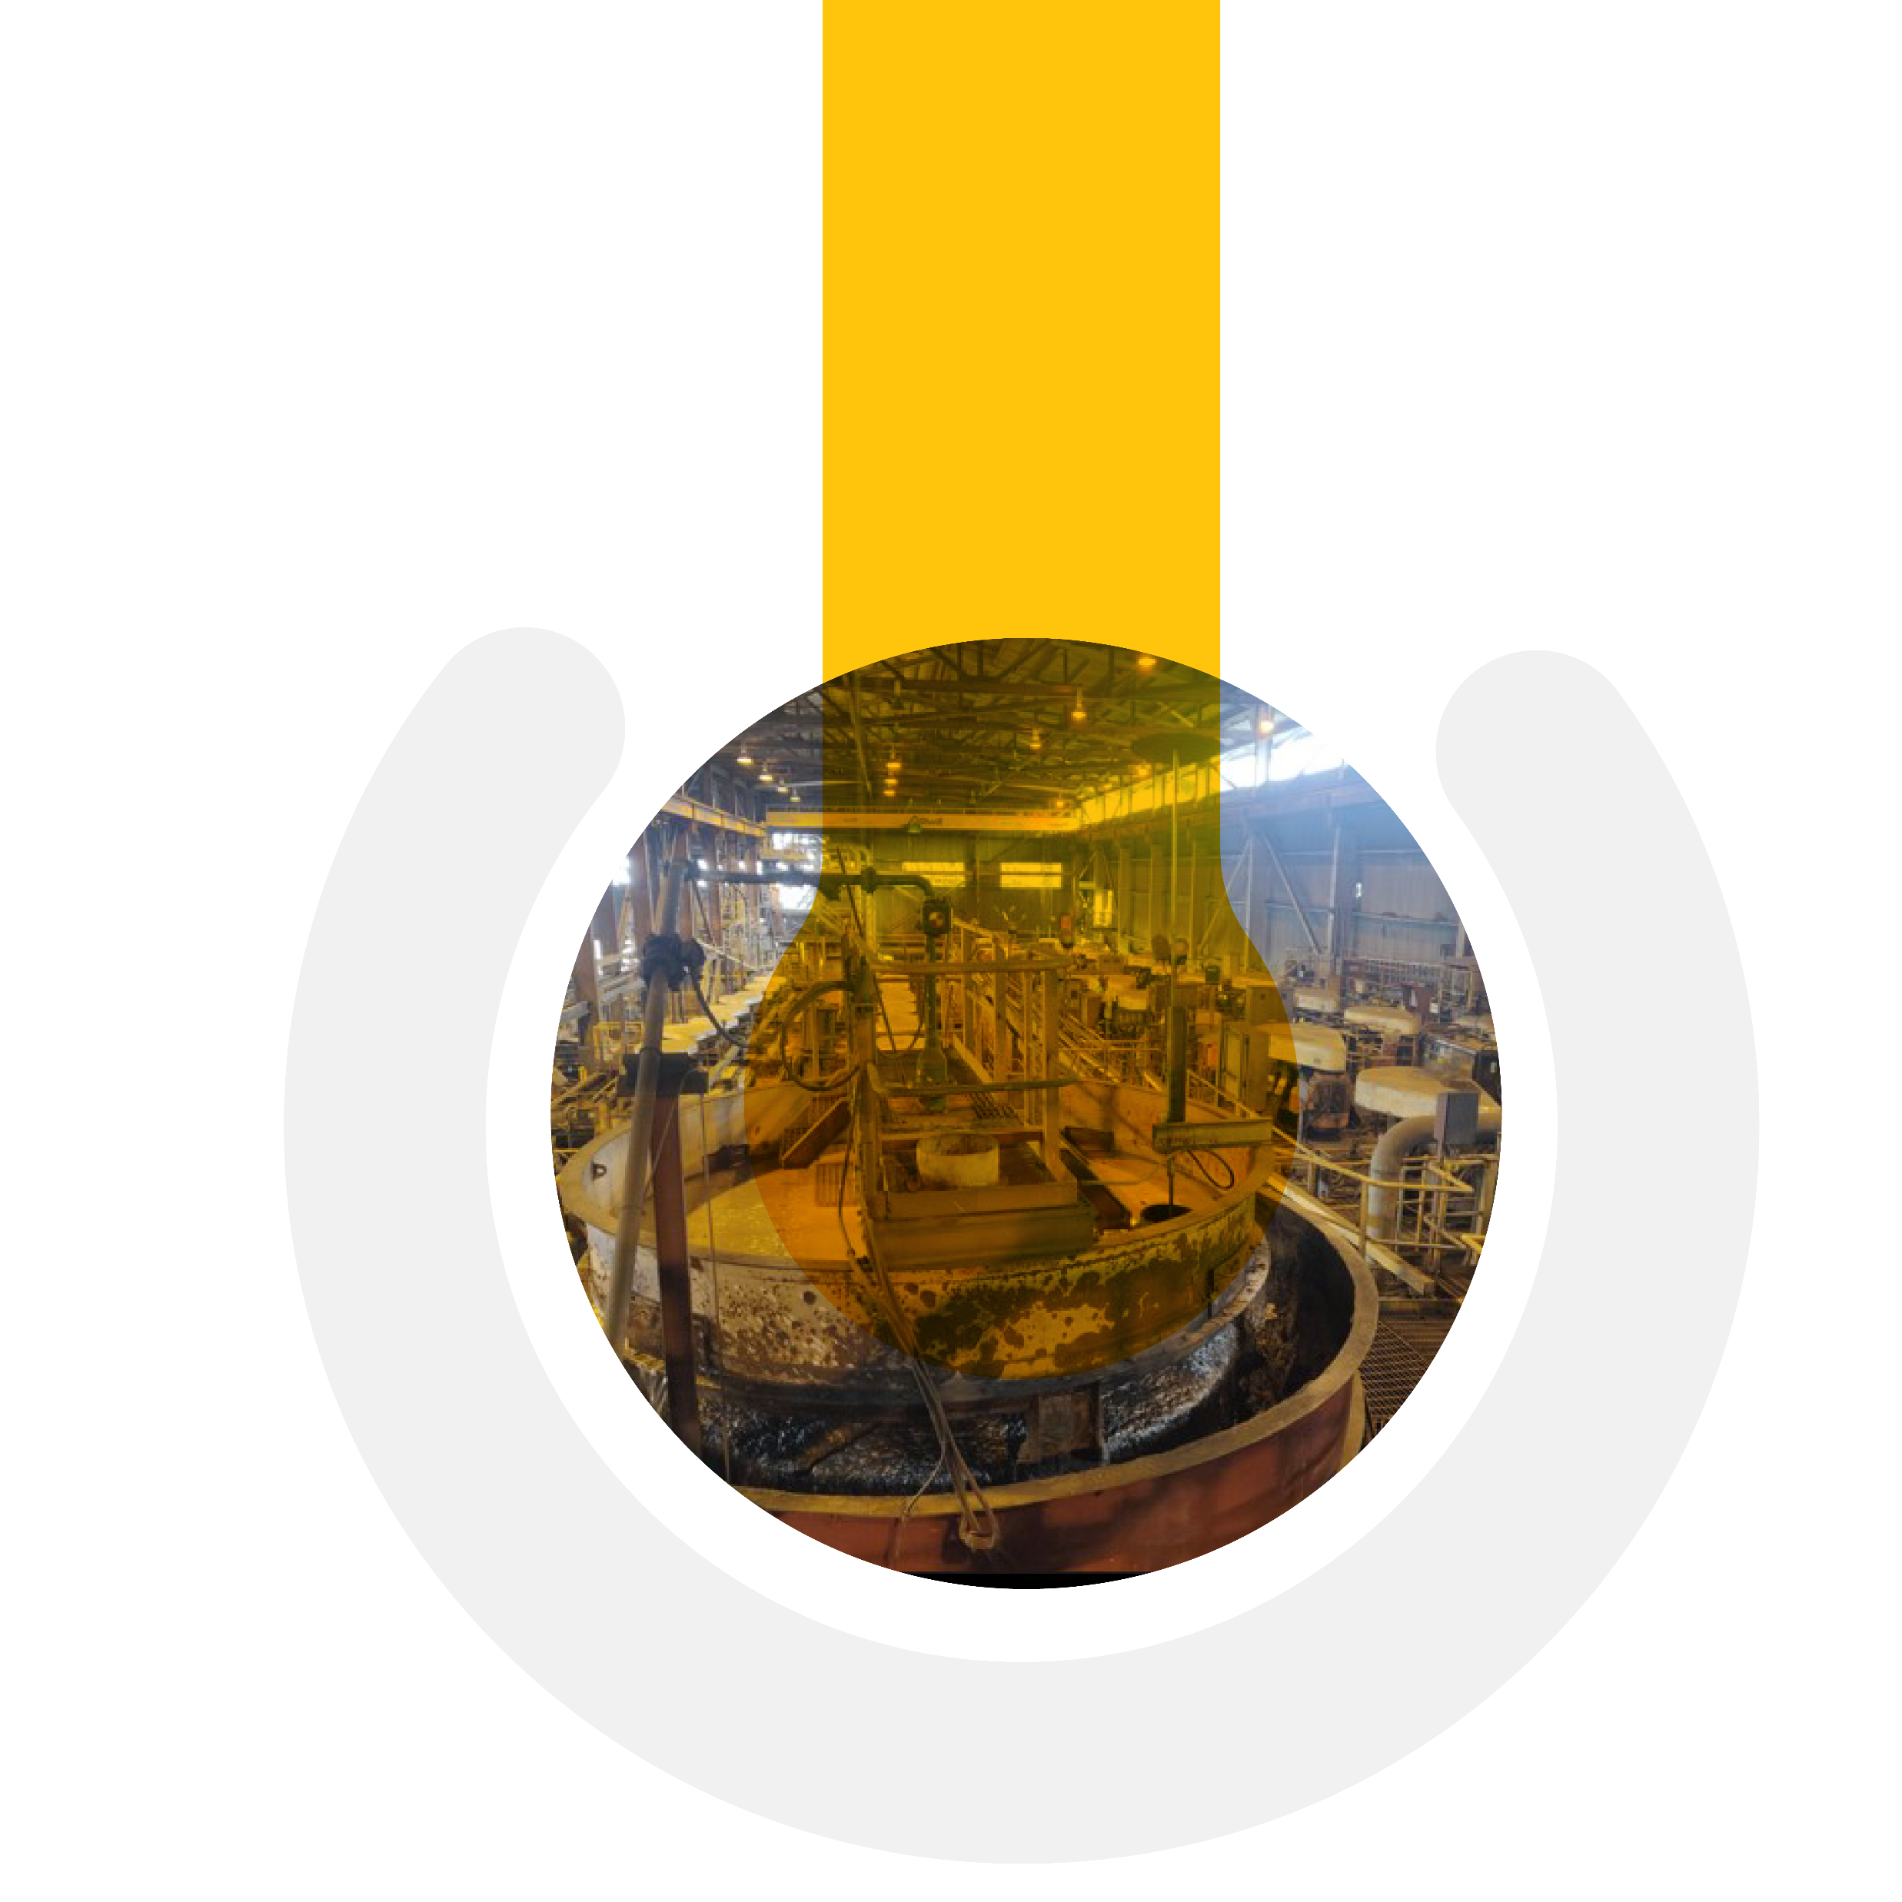
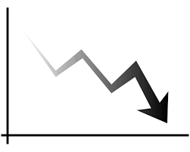



Problems at Ok Tedi
  Low gold and copper recovery
  Insufficient digital maturity for business intelligence
  Unstable operation,
  reacting and firefighting
  Manual operation
Notes:
Graham
Board approved and site commissioned a team to look into Processing Improvements.
Section was formed in 2018 to come up with a strategy on how to attack the problem.
Issues as per slide.

Slide 8
Solution:
Automation Roadmap

Slide 9

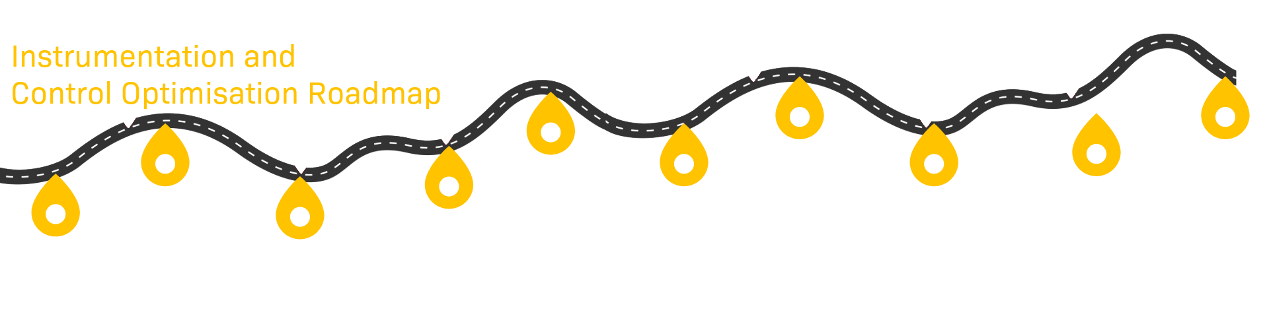
Online Knowledge Base, Support Desk and Project Management Platform
Training | Upskilling | Mentoring
Capability Development and Support
Project KPI Monitoring
2019
2020
2021
2022
2023
2024
present
Notes:
Graham

Slide 10
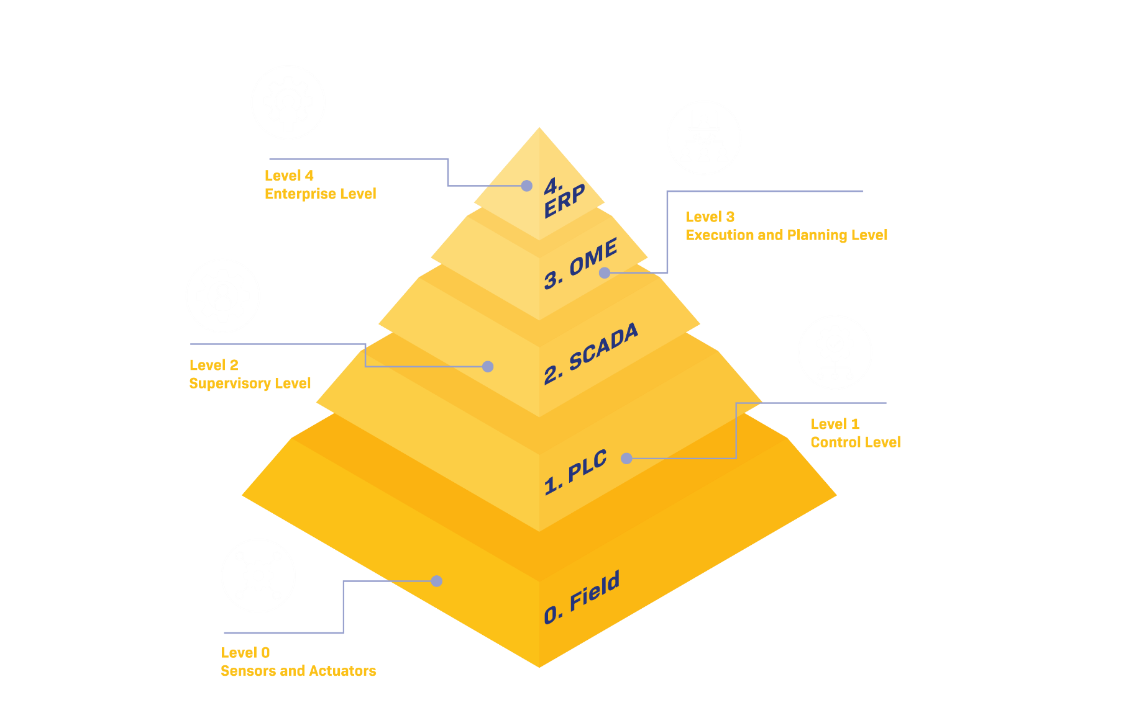
A stable data platform centering on the PI System
Starting at the bottom and
working our way up
  AVEVA Production Management – Crushing and Grinding areas with KPI (Availability and Utilisation)
  AVEVA Plant SCADA – Power generation HMI
  AVEVA PI System – Data historization and calculations
  Mipac MPA – Data visualisation
  Instrumentation upgrades and asset renewal
Notes:
Daniel
Other projects that tackle other lays of the au
Enabling technologies to make the data from PI easily available and accessible
tomation pyramid

Slide 11
Problem: Insufficient digital maturity for business intelligence
Solution:
Digital infrastructure
with the
AVEVA PI System
as the backbone
Notes:
This is the same as slide 10

Slide 12
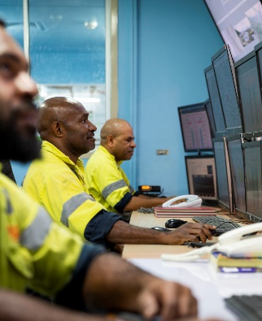

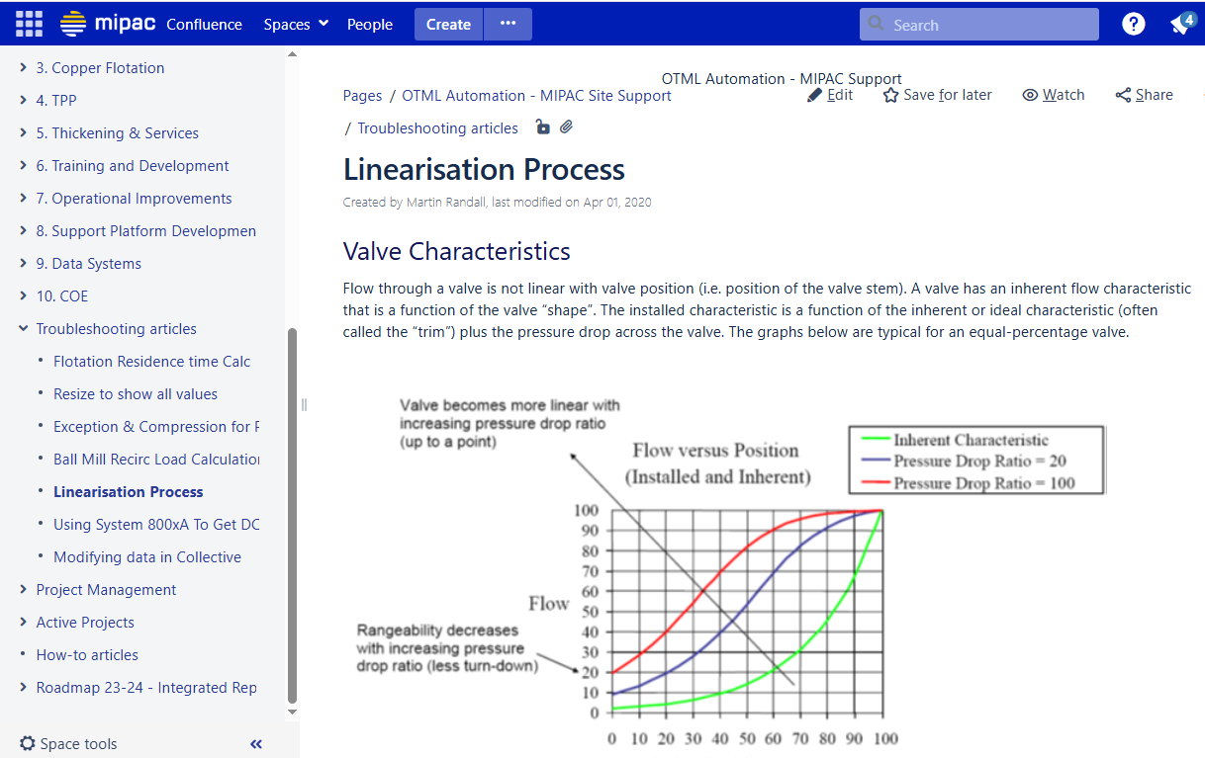
Automation Roadmap – People and Processes
Bringing people along as part of the automation roadmap
  Training and upskilling of site personnel.
  Improvement of confidence in the data and ways of working for operators.
  Creation of a web-based wiki-style knowledge base so that information can be created, organised and shared with Ok Tedi and their partners.
  Establishment of a Centre of Excellence (CoE) to continue improvements.
Notes:
Daniel
eLearning modules
Knowledge transfer of expats

Slide 13
Automation Roadmap – Infrastructure
Updated and Upgraded Infrastructure
  Buffering configured for all interfaces and connectors to data sources.
  Updated the PI system software and OS.
  Data was already consolidated on the SCADA side, PI interfaces consolidated to point only to the main SCADA system.
  Updated security to use PI identities.
  Creation of documentation.
Notes:
Daniel

Slide 14
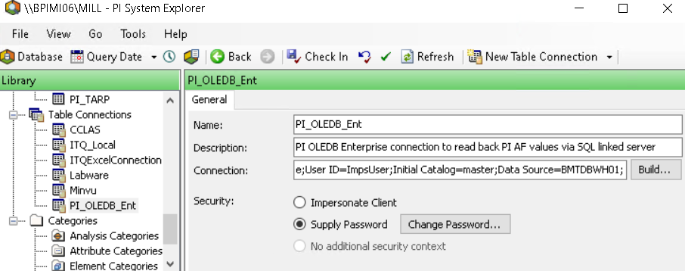
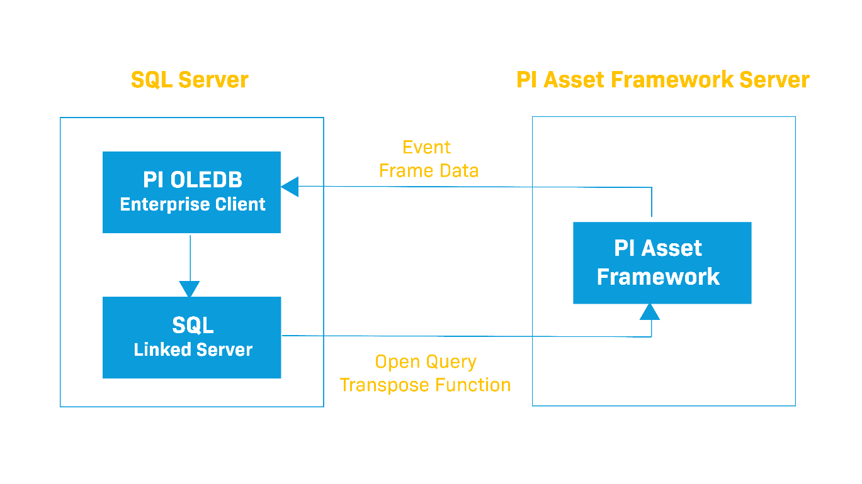
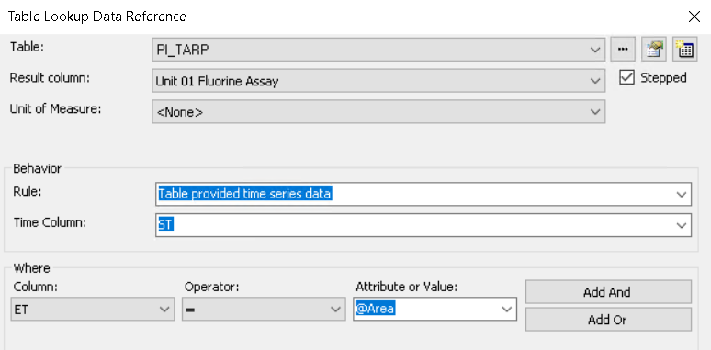
Automation Roadmap – AF Development and Calculations
Combining time series and event data in AVEVA PI
  Reading event frame data using PI OLEDB Enterprise into PI AF linked tables, using the tabled provided time series data rule in table lookups to view the data as time series.
  Using SQL functions to group data to find
  event-weighted averages/totals of attributes in event frames for a shift, day etc.
Notes:
Daniel
AF templates
PI OLEDB Enterprise is used, however this would work better with PI SQL client
Also allows lookups in history of a PI tag e.g. batch number (specific timing of a batch in control system and then batch assays with batch ID timestamped to shifts)

Slide 15
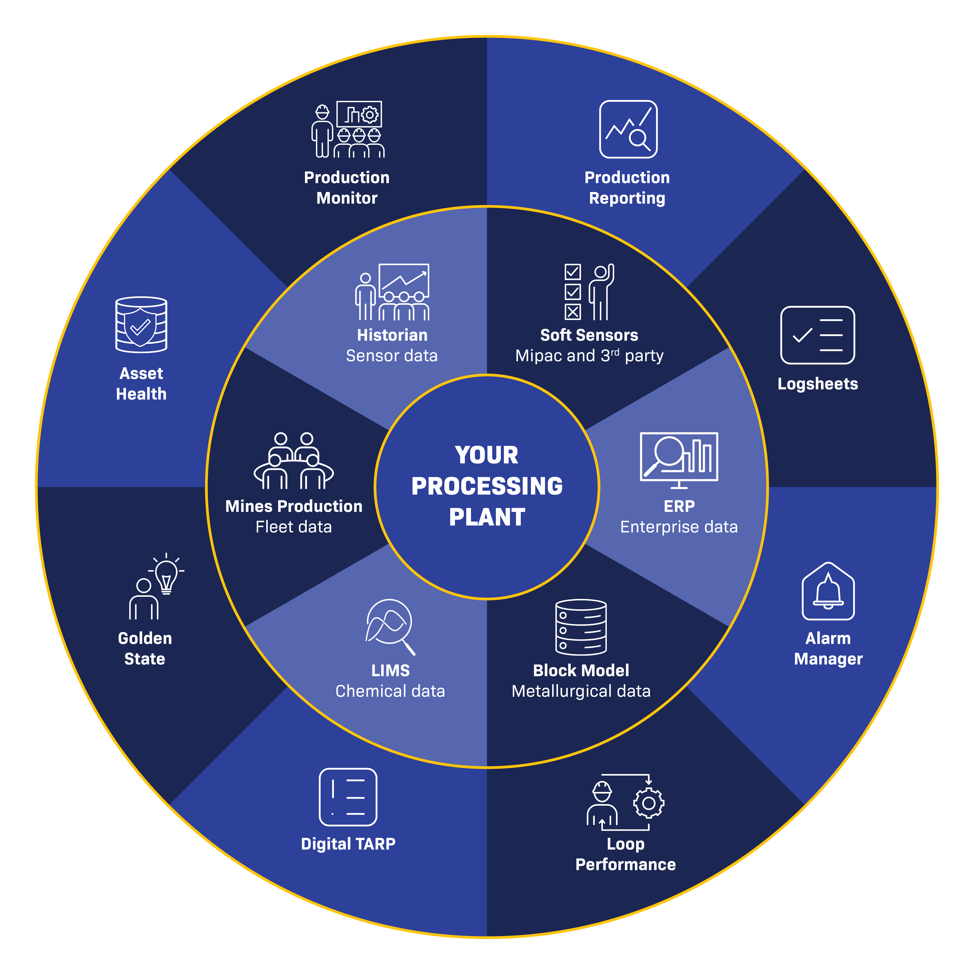

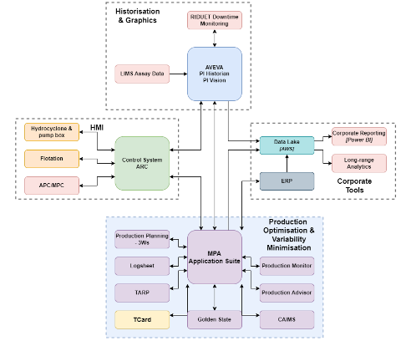
MPA is Mipac's suite of integrated applications designed to:
Visualise plant processes live
Detect production deviations early
Respond accurately to issues
Save time with reporting
Notes:
Daniel
MPA transforms mineral processing operations with a software suite for live visualisation of plant processes and timely detection & accurate frontline response to production deviations. This approach empowers the frontline team to make informed decisions on time and ensure minimum production losses without waiting for directions in the next production meeting.

Slide 16
Problem:
Unstable operations of the plant
Solution:
Short Interval Control and other displays and dashboards

Slide 17
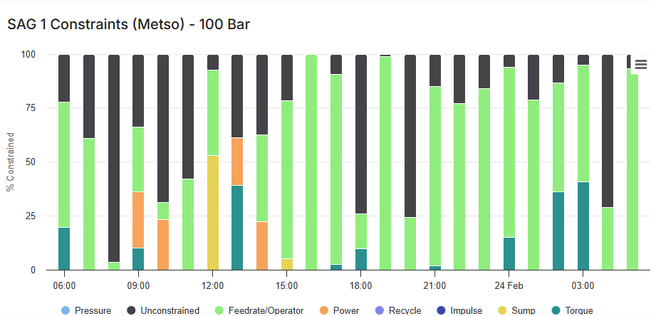
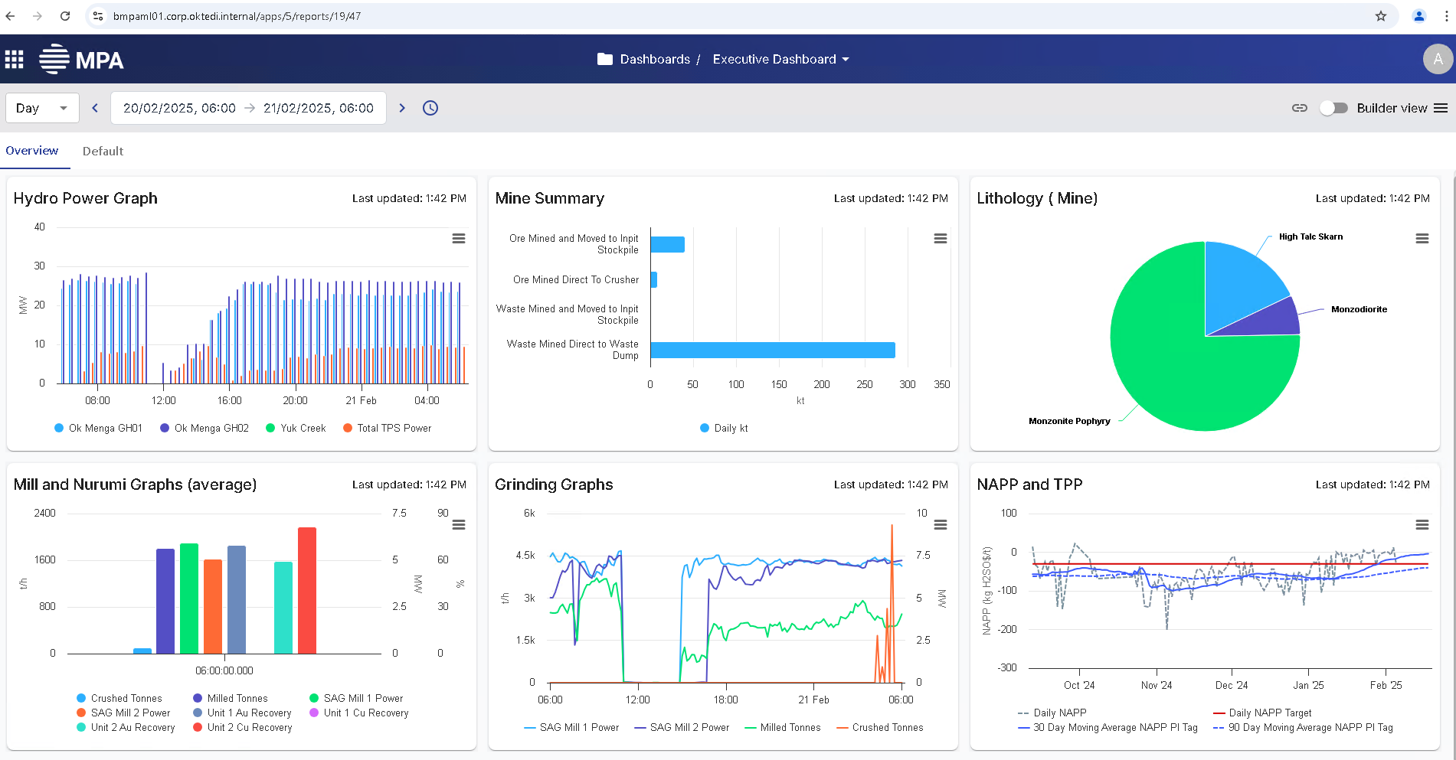
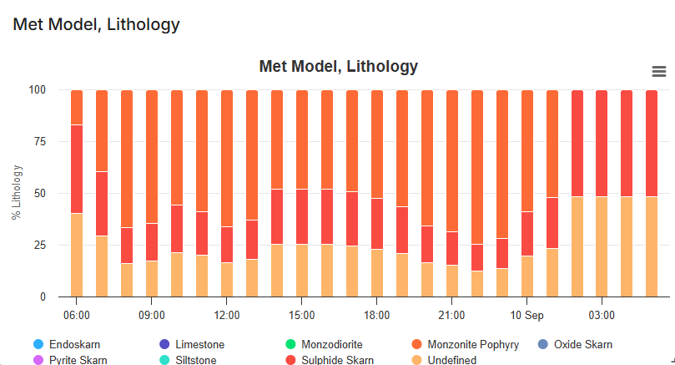
Automation Roadmap –Visualisation
High-level operational overview dashboards allowing easy access and interpretation of data
  High-level displays showing values against targets to easily identify deviations and process issues.
  Drill down functionality to quickly diagnose deviations.
  Short interval control (SIC)
  Expert system constraints (SAG Mill)
  Lithology of the feed coming into the plant
  Errors between assays
  (lab vs in-stream analyser)
Notes:
Daniel
Landing page to give overall status of the plant,
Then enabling drill down to look at specific areas of the plant to each quick troubleshooting

Slide 18
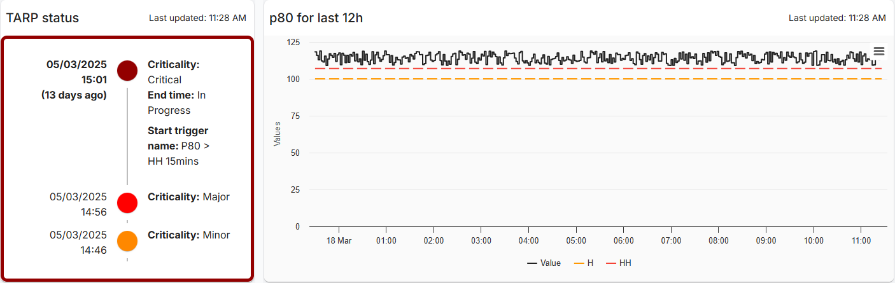
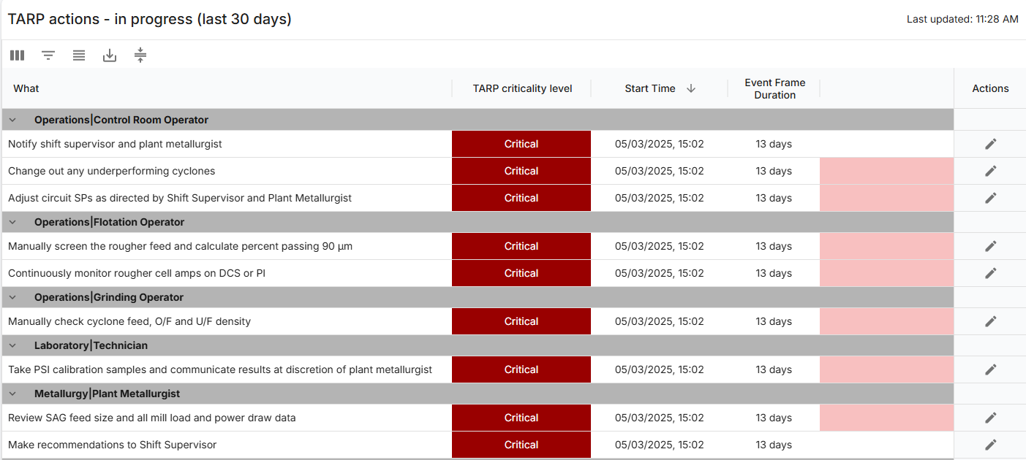
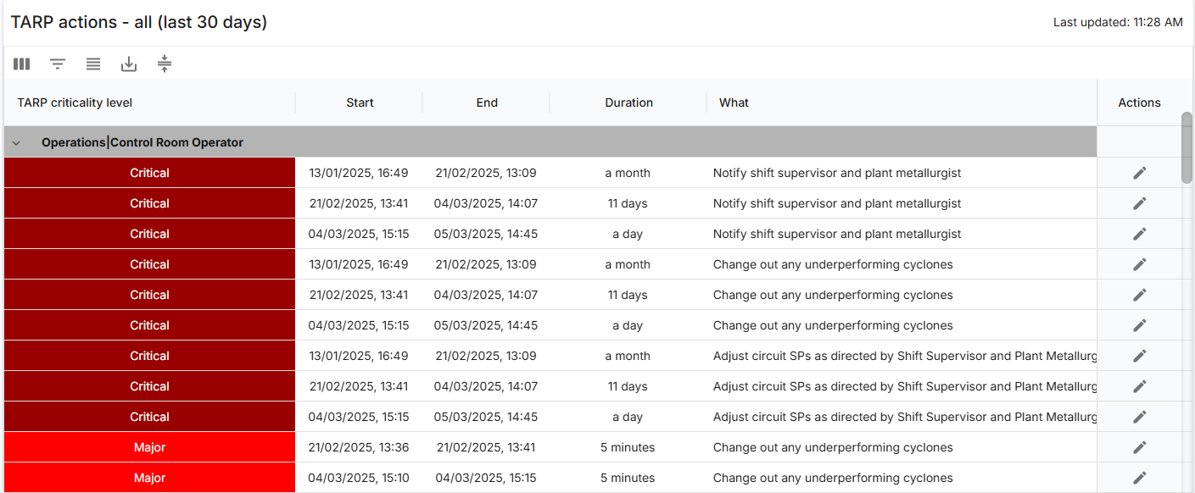
Automation Roadmap –Visualisation
Trigger Action Response Plan (TARP)
  A plan with a set of actions required when certain abnormal situations occur.
  Triggered automatically from process conditions.
  Flow chart requiring both actions and comments from different parties using event frames.
Notes:
Daniel
Mention alarm manager and golden state currently being deployed

Slide 19
Problem:
Manual operation
of the plant
Solution:
Control Loop Reports
via MPA identifying
loops in manual mode

Slide 20

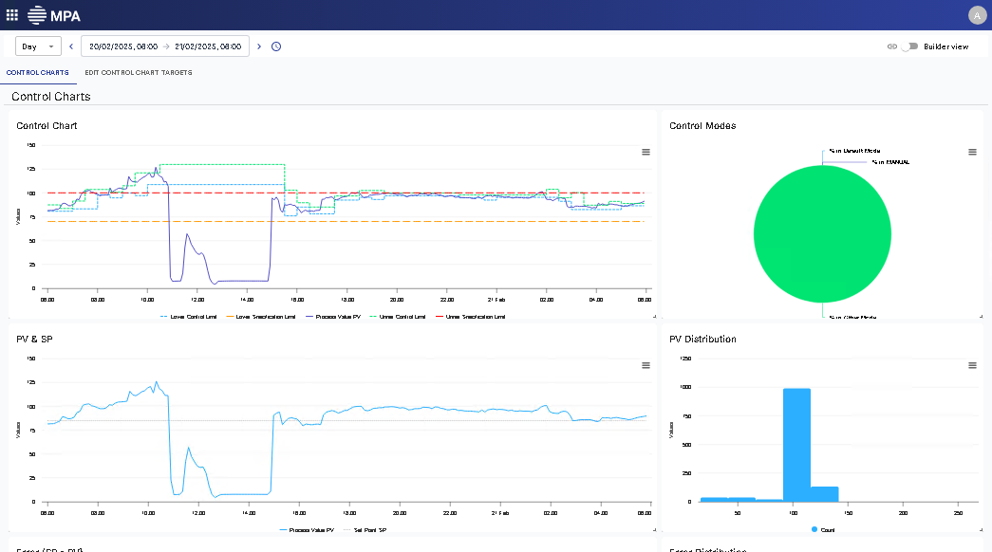
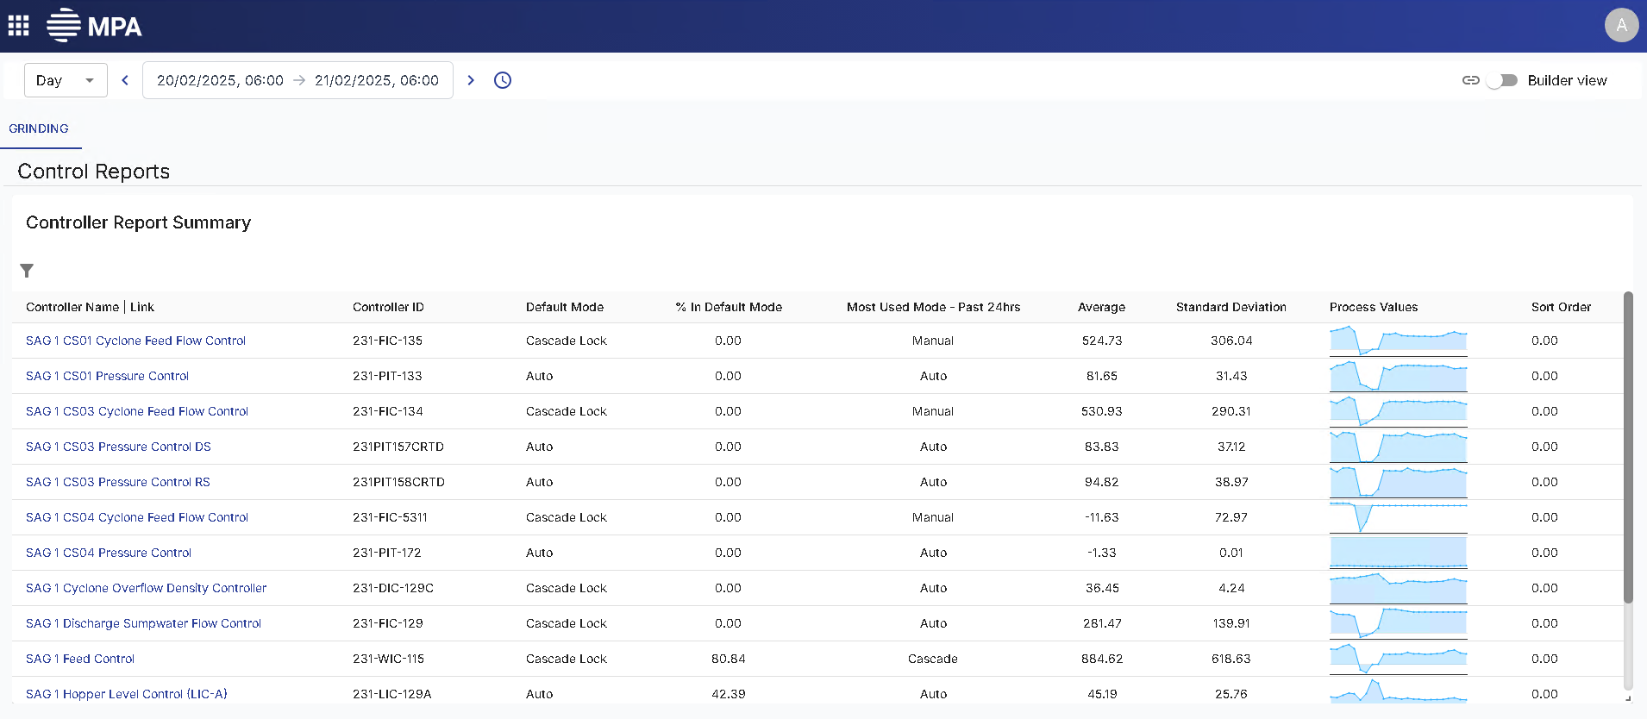
Automation Roadmap –Visualisation (Controller Reports)
Improving efficiency by building confidence in the data
  Identifying controls in manual and providing training to the operators
  Identified opportunities in the data and introduced cascade control around water addition and auto control of cyclones utilizing pressure and feed-forward control in cell-level controls.
Notes:
Graham
Background – flotation, grinding (mention specific areas of the plant)
three and a half years ago, we would be experiencing frequent downtimes due to standing up of cycling feed lines, and that was again as a result of manual operation and equipment issues that, as a result of that, it resulted in us actually doing a major exercise around calibrating and tuning surrounding instrumentation.
We also introduced a number of control logics in terms of cascade control around water addition and auto control of cyclones utilizing pressure.
In addition to that, we had to train up the control room operators to be able to handle these changes because they were so used to operating in manual for such a long time
We had serious issues with our cell level controls, and this resulted in a lot of loss in recovery.
So, apart from the metallurgical parameter manipulations, we introduced feed-forward control to replace the unreliable control system at the time, and this resulted in greater control of the levels, consistent throughout the overflow, mass flow and subsequently concentrate grade.

Slide 21
Problem:
Equipment reliability leading to unstable operation of the plant
Solution:
AVEVA Production Management and Predictive Maintenance
Notes:
Same as slide 35

Slide 22
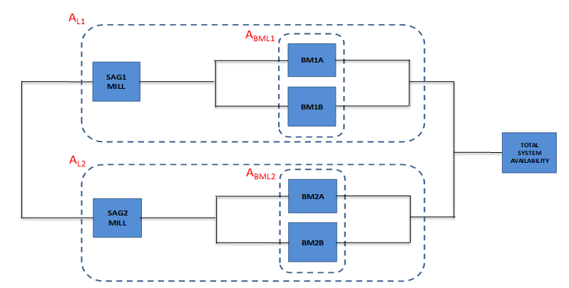
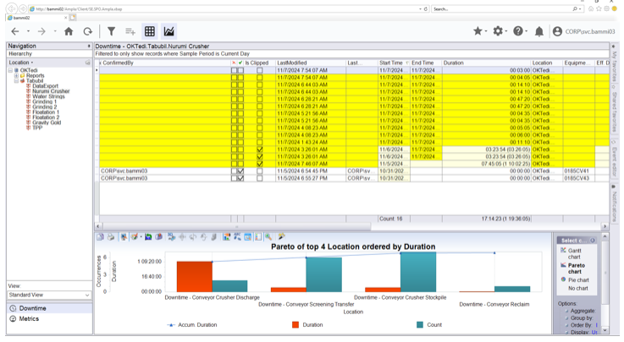
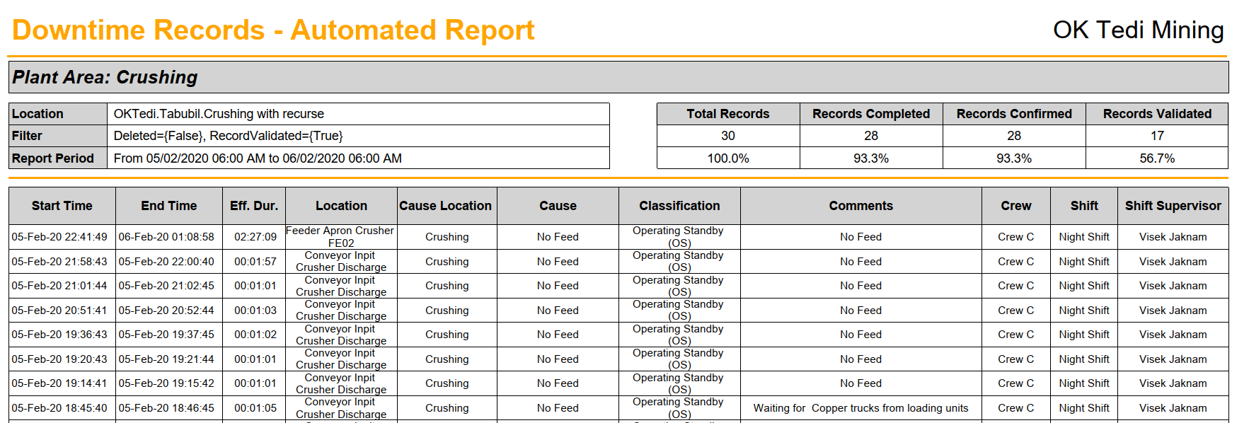
Automation Roadmap – Reliability (Production Management)
Capturing and classifying plant and equipment downtime data for insights into improvements
  Data from Production Management is used as inputs for further analysis such as predictive maintenance.
Notes:
Graham
Milling and Crushing areas
MinVu – Downtime shown
Leads to predictive maintenance

Slide 23
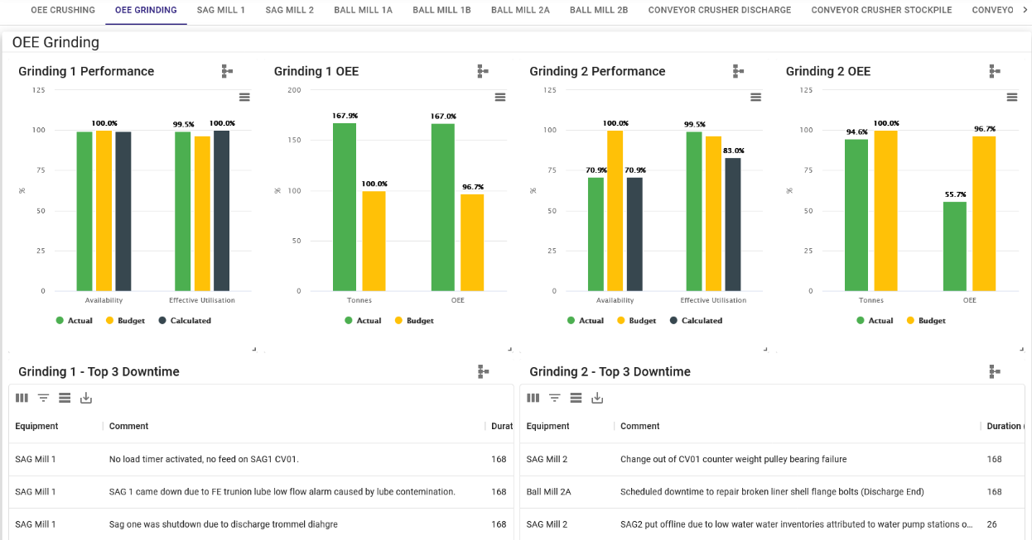
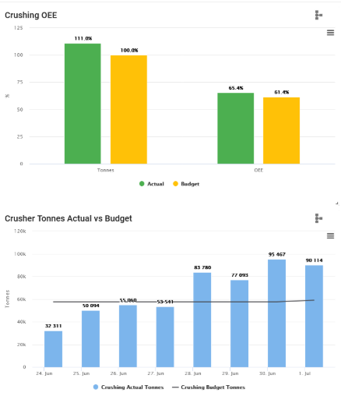
Automation Roadmap – Reliability (Production Management)
Data from AVEVA Production Management is used to produce reliability KPIs
Notes:
Graham
Expansion into Power Assets and Power BI

Slide 24
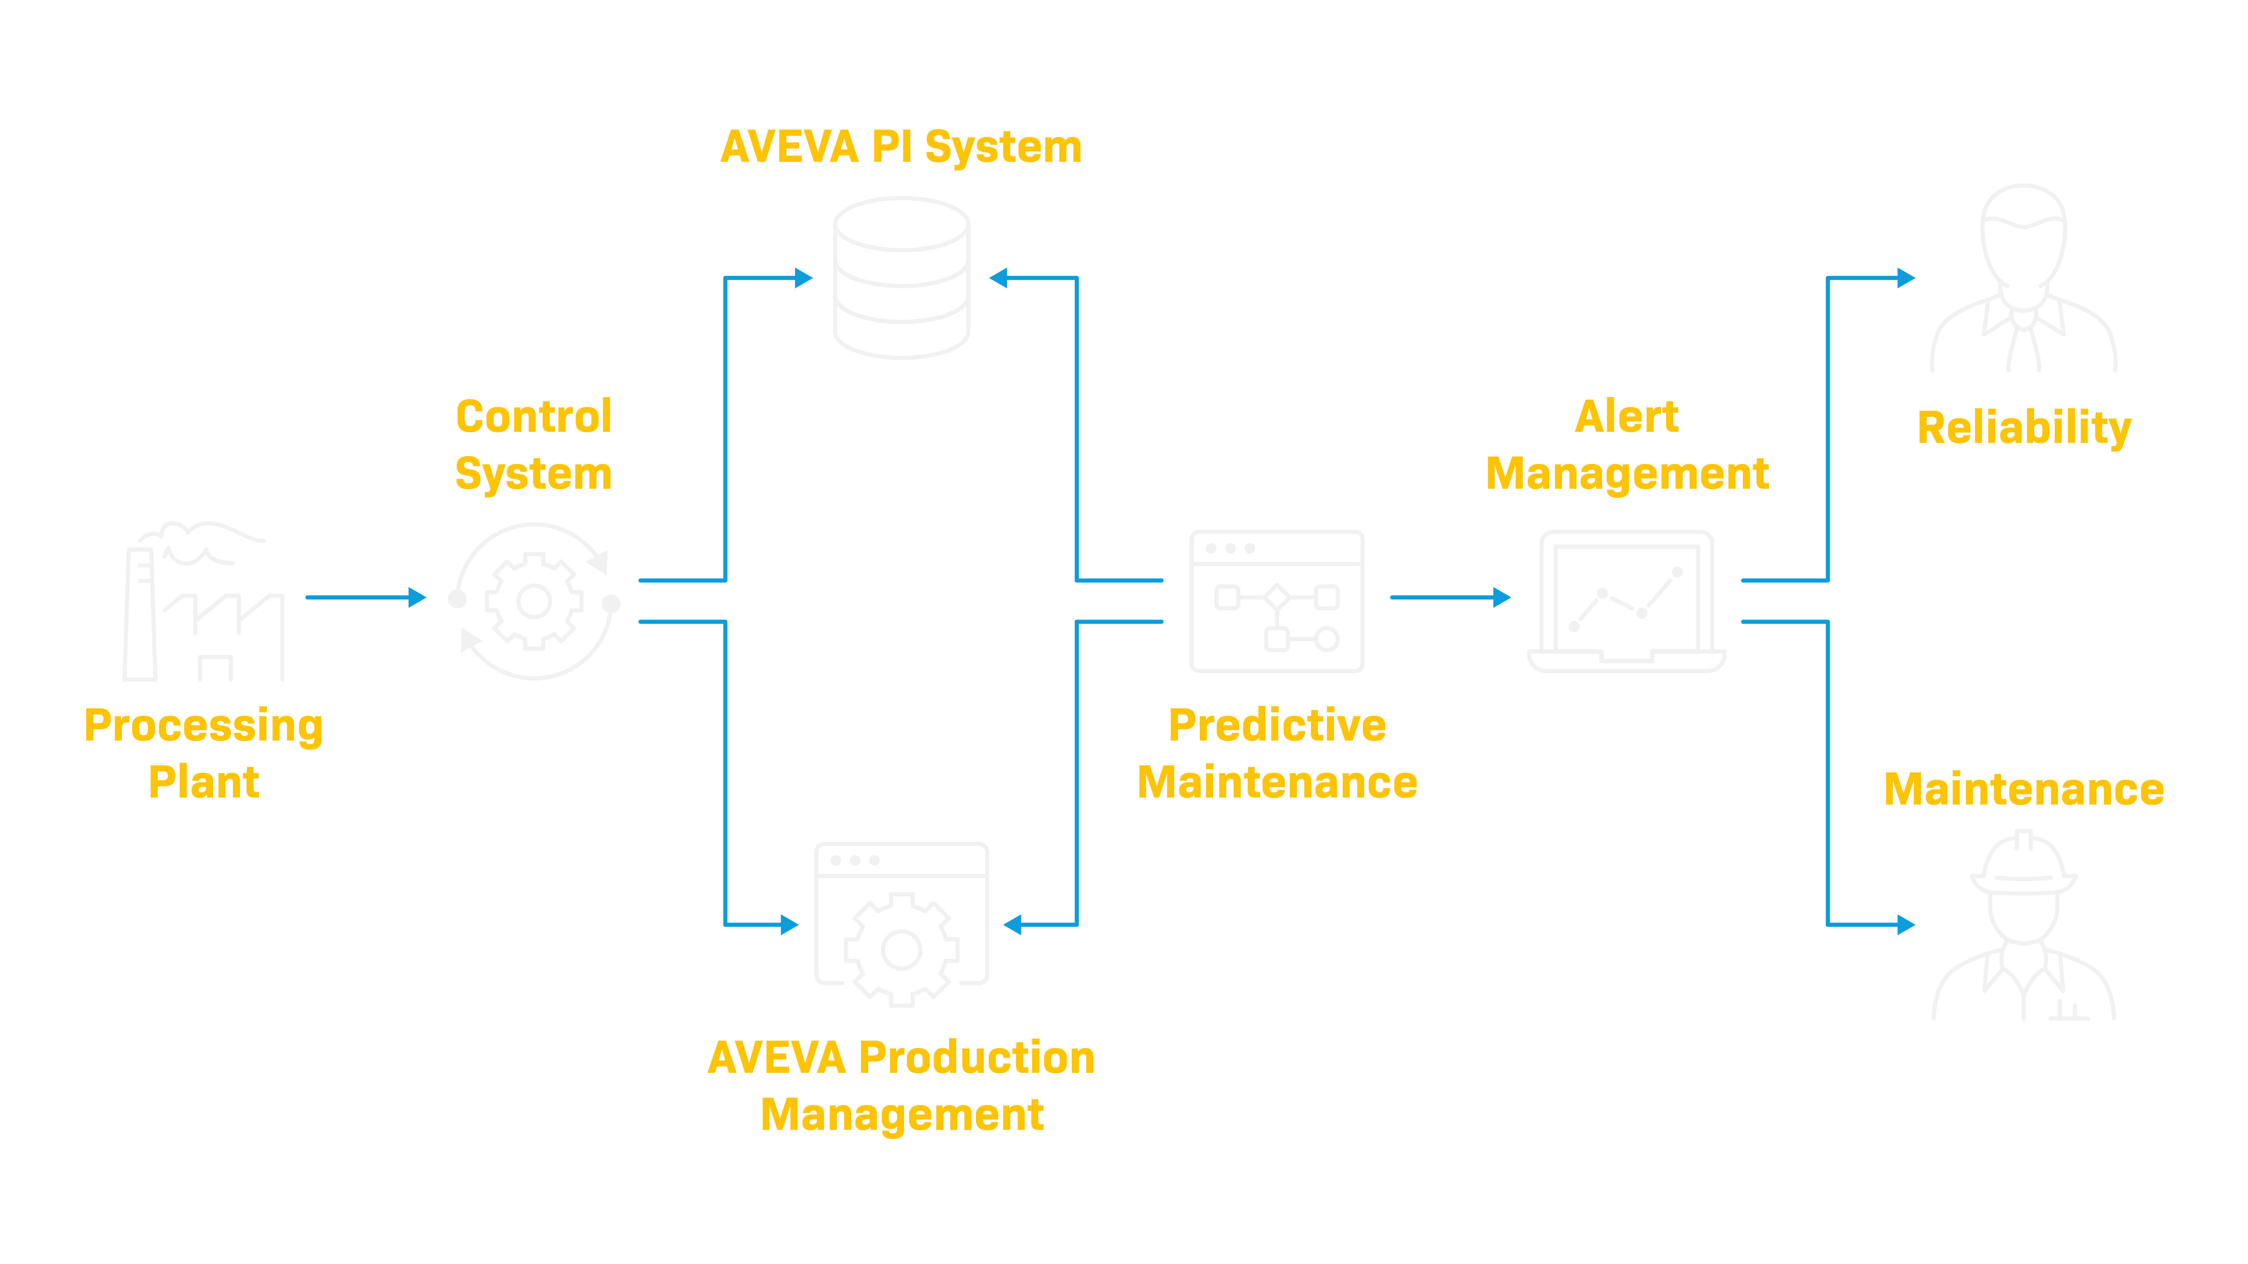
Automation Roadmap – Next steps and the Future
Predictive Maintenance using PI data
  Combining live and historical time-series data from AVEVA PI with downtime events from AVEVA Production Management and feeding this into predictive maintenance software to create alerts on abnormal conditions detected on major equipment.
Notes:
Daniel
Going through this process of gathering and feeding data for a predictive maintenance additional gaps were identified in terms of missing data in PI such as trunnion lube system for the SAG mills

Slide 25
Summary

Slide 26


MINING AND MINERALS PROCESSING | Papua New Guinea
Ok Tedi Mining improves Recovery
Challenge
  Low gold & copper recovery
  Insufficient digital maturity for business intelligence
  Unstable operation, reacting and fire-fighting
  Manual operation
Solution
  Deployed AVEVA PI System to streamline data collection, access, analysis and reporting
  Deployed AVEVA Production Management to capture downtime and produce KPI
  Deployed Mipac's MPA software to visualise AVEVA PI data and gain process insights
Results
  Improved Au recovery from 55% to 70%
  Improved Cu recovery from 83% to 89%
Notes:
Graham

Slide 27



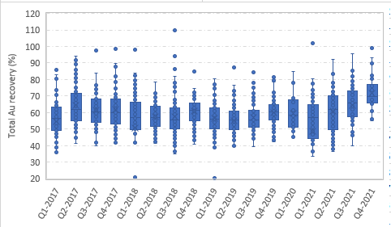
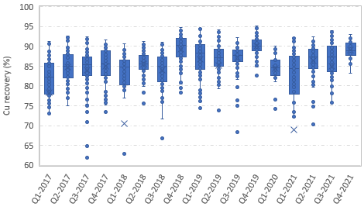
Outcomes
  Contribution to increased recovery:
  Au 55% to 70%
  Cu 83% to 89%
  Enhanced digital maturity
  Stable, automated operation and time for improvements
Notes:
Graham
This is the result of the changes over the 3.5 years which reflects an increase in recovery as shown.
Of the initial strategies put in place, 67% of the actions have been the enablers for this improvement.
It is independent of head grade, S:Cu ratio and concentrate grade.
This data has been validated by JKTech for the purposes of this presentation as shown.

Slide 28

Daniel Qiao
Lead Systems Specialist
  Mipac (AVEVA - PI Systems Integrator)
  Daniel.Qiao@mipac.com.au

Slide 29


Questions?
Please wait for the microphone.
State your name and company.
Please remember to…
Navigate to this session in the mobile app to complete the survey.

Slide 30
This presentation may include predictions, estimates, intentions, beliefs and other statements that are or may be construed as being forward-looking. While these forward-looking statements represent our current judgment on what the future holds, they are subject to risks and uncertainties that could result in actual outcomes differing materially from those projected in these statements. No statement contained herein constitutes a commitment by AVEVA to perform any particular action or to deliver any particular product or product features. Readers are cautioned not to place undue reliance on these forward-looking statements, which reflect our opinions only as of the date of this presentation.
The Company shall not be obliged to disclose any revision to these forward-looking statements to reflect events or circumstances occurring after the date on which they are made or to reflect the occurrence of future events.

Slide 31

linkedin.com/company/aveva
@avevagroup
About AVEVA
AVEVA is a global leader in industrial software, sparking ingenuity to drive responsible use of the world’s resources. The company’s secure industrial cloud platform and applications enable businesses to harness the power of their information and improve collaboration with customers, suppliers and partners.
Over 20,000 enterprises in over 100 countries rely on AVEVA to help them deliver life’s essentials: safe and reliable energy, food, medicines, infrastructure and more. By connecting people with trusted information and AI-enriched insights, AVEVA enables teams to engineer efficiently and optimize operations, driving growth and sustainability.
Named as one of the world’s most innovative companies, AVEVA supports customers with open solutions and the expertise of more than 6,400 employees, 5,000 partners and 5,700 certified developers. With operations around the globe, we are headquartered in Cambridge, UK and listed on the London Stock Exchange’s FTSE 100.
Learn more at www.aveva.com

